Slide 1
PSY102: Introduction to Cognitive Psychology
Day 3 (05/17/19): Perception

Slide 2
Today’s Goals + Agenda
Continue to build a supportive classroom culture & discuss open science & methodology used for different studies.
In teams, fill out the study vignettes
Jeopardy style Qs on the open science reading
Describe some basic perceptual perspectives and principles.
Discuss 4 perspectives on perception: learning-focused (Helmholtz, Statistical Learning, Bayesian) and intrinsic (Gestalt)
If there's time, handout on depth processing cues
Deconstruct and analyze the findings of an academic journal article.
Apply the reading worksheet to Gruters et al. (2018)
Discuss the main takeaways of the Gruters paper as class
Compare and contrast models of science communication.
Yong vs. Gruters; Yong vs. Dean

Slide 3
“Do you follow a particular news source?”
“I don’t follow the news.” (1)
NYT (2 folks)
News on phone (1), twitter/social media (2), internet browsing/google (2)
WSJ or social media (1)
National Geographic or social media (1)
MIT lab news (1)
Most of you, when accessing a science news article, see it because it’s in your feed (personalized by friends or internet cookies), and some of you follow specific news sources.
Notes:
Yesterday’s minute paper

Slide 4
Applying Cognitive Methodology
Continue to build a supportive classroom culture & discuss open science & methodology used for different studies.

Slide 5
Vignettes: Don’t Look at the Back Yet
In groups of 3-4:
The person with the longest hair is going to read the study out loud to the group. Then you’ll work together to answer the questions listed; the person with the shortest hair will write down the answers on the large sheet of paper.
Note that level 1 material is generally content that you’ll be expected to know on assessments. Level 2 goes beyond it -- but it’ll help you contextualize the material to help you do even better on assessments, help with reading academic papers, and help with your goals of seeing psychology in your future careers.
You’ll have 8 minutes per vignette and then you’ll check your answers from the vignette for 2 minutes. We’ll come together to discuss shortly thereafter.
Notes:
(Note: this took longer than I expected)

Slide 6
Review: Research Methods
Correlational versus experimental designs
How to compare the sign and absolute value of correlations
Independent and dependent variables (IVs and DVs)
Within- and between-subject experiments
The importance of random assignment
Reliability versus validity
Descriptive statistics
Measures of central tendency (mean, mode, median)
Standard deviation
Inferential statistics
P-values
Null hypotheses
Notes:
-> if you don’t know these concepts, let’s chat

Slide 7
Open Science & WEIRD Samples
Assess current problems within psychological methodology such as WEIRD samples and the lack of open science

Slide 8
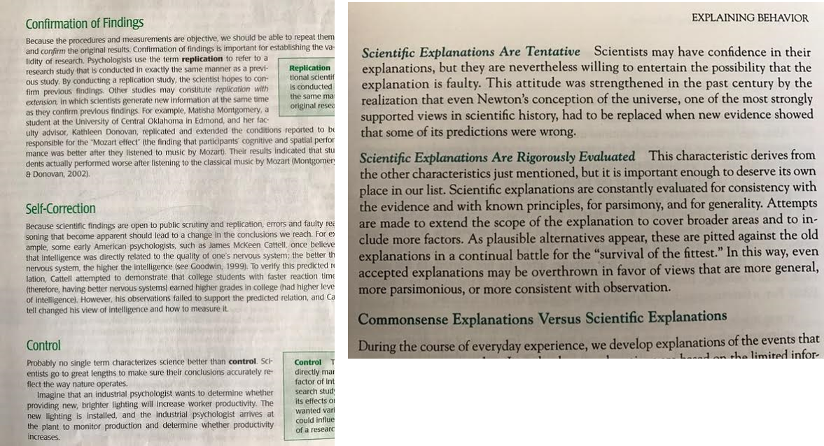
Scientific Ideals
Left, Smith & Davis The psychologist as detective: An introduction to conducting research in psychology
Above, Bordens & Abbot Research design and methods: A process approach
Notes:
Connect back to discussion wednesday about scientific knowledge & all models are false

Slide 9
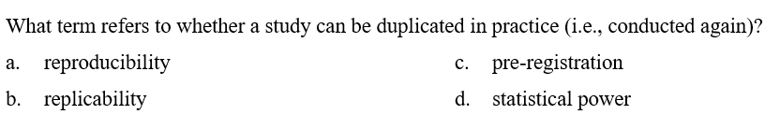
Credit: https://osf.io/bts5d/wiki/home/
Notes:
Answer: A
(read lab manual, should be able to answer these)

Slide 10
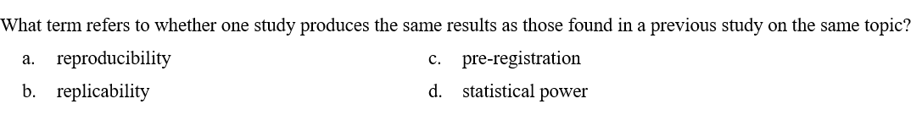
Credit: https://osf.io/bts5d/wiki/home/
Notes:
Answer: B

Slide 11
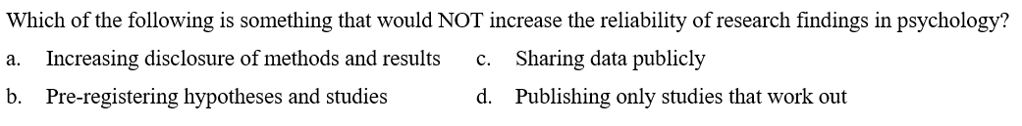
Credit: https://osf.io/bts5d/wiki/home/
Notes:
Answer: D

Slide 12
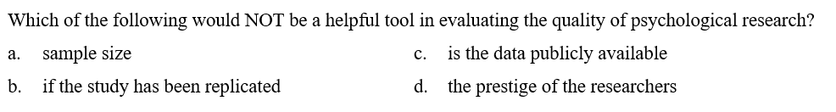
Credit: https://osf.io/bts5d/wiki/home/
Notes:
Answer: D
-connect back to discussion on all models are false

Slide 13
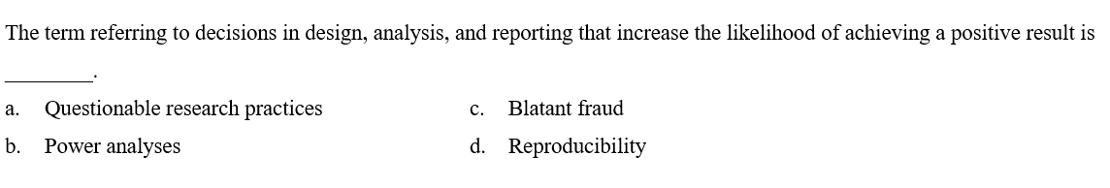
Credit: https://osf.io/bts5d/wiki/home/
Notes:
Answer: A

Slide 14
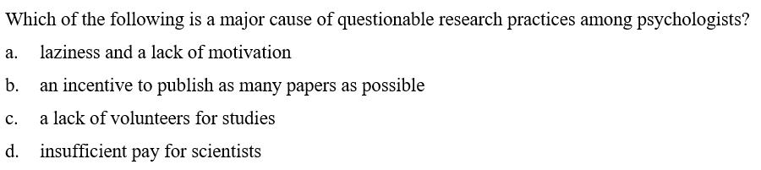
Credit: https://osf.io/bts5d/wiki/home/
Notes:
Answer: B

Slide 15
Scientific Realities
•Publication pressure & bias
•Selection bias
•Fraud
•Failure to replicate
•Inflation (p-hacking); demo1, demo2
•Questionable Research Practices (QRP)
Credit: https://osf.io/3mv76/
Notes:
-should have read about these in the lab manual
-give examples of QRPs

Slide 16
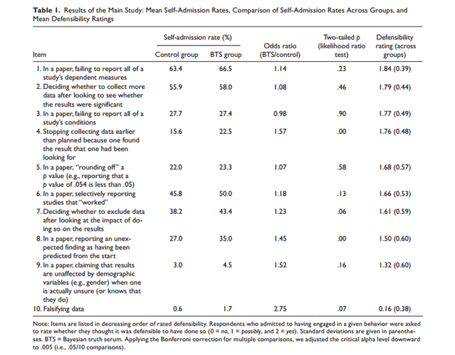
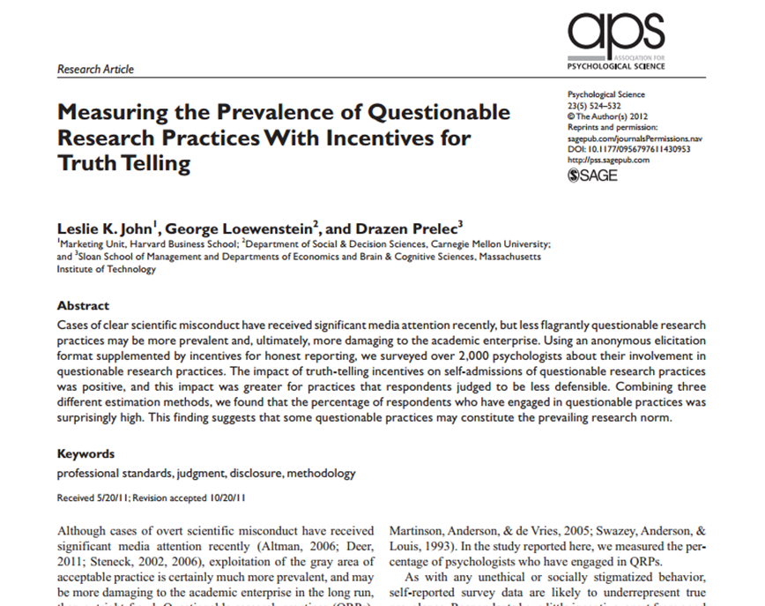
QRPs:

Slide 17


What are potential solutions?
And:
What should we keep in mind while reading these academic articles?
How does this impact SciComm?
Notes:
-Reproducibility projects
-Crowdsourced projects
-Badges
The lab manual referred to open science principles such as:
-preregistration (Open Science Framework)
-open lab notebooks
-codebooks
-managing projects on the Open Science Framework
-Start-to-Finish Project checklists
-detailed documentation
-open materials
-cooperate with replicate studies
-changing the academic publishing system

Slide 18
Application to SciComm Principles
Verification of field: does this result come out of nowhere? Look at long-term validity (Yong (2019) example).
Getting the opinion of other experts usually helps contextualize results; you can also report on another similar paper

Slide 19
And, Despite Crisis...
Psychological science can yield reproducible results
The field is changing to allow for better methodology
Lillenfeld, 2012, American Psychologist
Notes:
Lilienfeld, S. O. (2012). Public skepticism of psychology: why many people perceive the study of human behavior as unscientific. American Psychologist, 67(2), 111.
Lilienfeld, S. O., Lynn, S. J., Ruscio, J., & Beyerstein, B. L. (2011). 50 great myths of popular psychology: Shattering widespread misconceptions about human behavior. John Wiley & Sons.

Slide 20
Perception
Describe the basic principles thought to underlie perception and perceptual illusions.

Slide 21
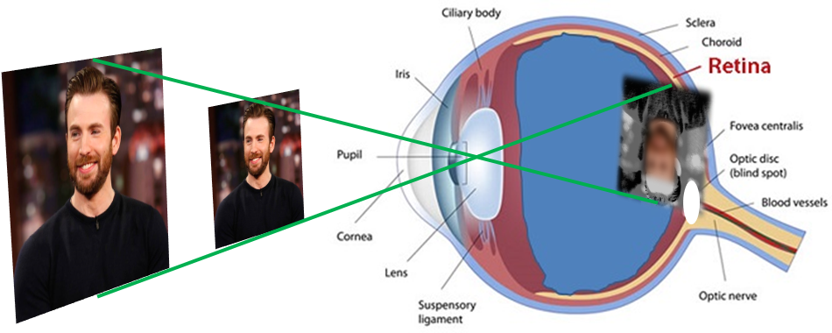
The Inverse Projection Problem
Notes:
Light from an object is inverted as it falls on the retina. The same pattern of light could be caused by an infinite number of different objects, yet our brains usually manage to make the correct interpretation. This is known as the inverse projection problem.
Slide image from Ellie Hanna

Slide 22
Top-down vs. Bottom-up
Bottom-up: usually refers to start of stimulus processing
Top-down: processing originating in the brain, possibly other signals modulating bottom-up
Notes:
o Bottom-up processing: ‘bottom’ or beginning of the cognitive system, when environmental energy stimulates the visual receptors (i.e., usually bottom-up in relation to the initial processing of the stimuli)
o Top-down processing: processing that originates in the brain, at the top of the perceptual system (typically viewed as other signals that modulate bottom-up)
§ Knowledge helps us characterize blurred ‘blobs’
§ Hearing words in a sentence: where one word ends and the next one begins (speech segmentation); people familiar with different languages can hear different stimuli in such segments
§ Experiencing pain: can be influenced by what a person expects, how the person directs his or her attention, and the type of distracting stimuli that are present; decrease in pain from a substance that has no pharmacological effect is the placebo effect
· Sometimes with children, they’re crying when they have a booboo not because it hurt immediately, but when they realized it hurt (and/or in reaction to the rxn of their parents)

Slide 23
4 Perspectives on Perception
Helmholtz: retinal image ambiguous, so it solves ambiguity with the likelihood principle
We perceive the object most likely to have caused the pattern of stimuli we received
Unconscious inference: our perceptions are also often the result of unconscious assumptions or inferences we make about the environment
I.e., Expectation and experience play a large role in perception, and sometimes we’re not even aware of that

Slide 24
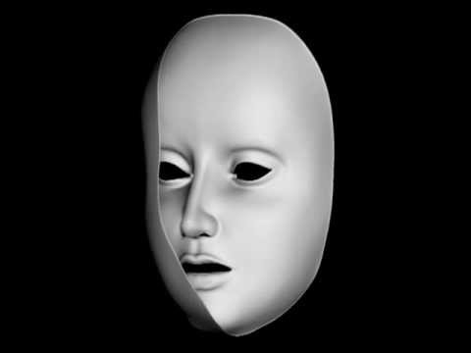
Notes:
https://www.youtube.com/watch?v=sKa0eaKsdA0
“This amazing illusion is so strong that even when we are aware that we are looking at the concave, reverse side of the mask we cannot stop ourselves perceiving it as a convex, protruding face!”

Slide 25
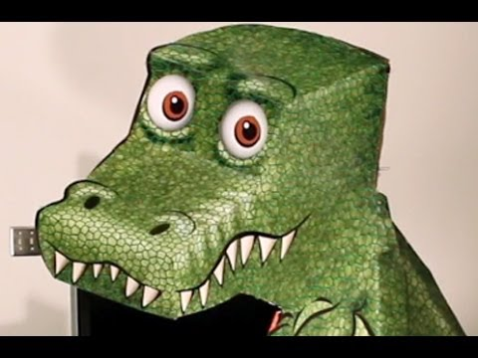
Notes:
https://www.youtube.com/watch?v=A4QcyW-qTUg

Slide 26
4 Perspectives on Perception
Statistical regularities in the environment
The oblique effect
Light-from-above
Semantic regularities
I.e., Expectation and experience play a large role in perception, and sometimes we’re not even aware of that

Slide 27
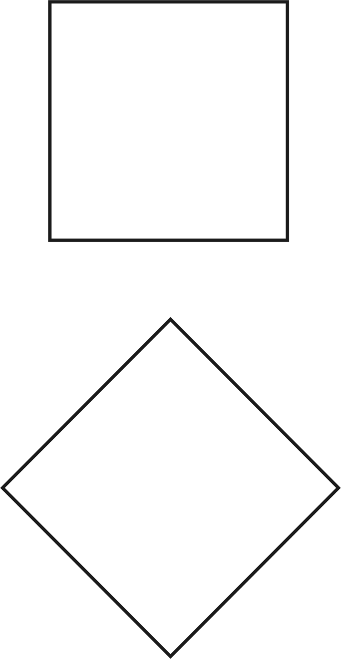
The Oblique Effect
Notes:
§ People can perceive horizontals and verticals more easily than other orientations (“the oblique effect”)
https://en.wikipedia.org/wiki/Oblique_effect#/media/File:Machsquare.png

Slide 28
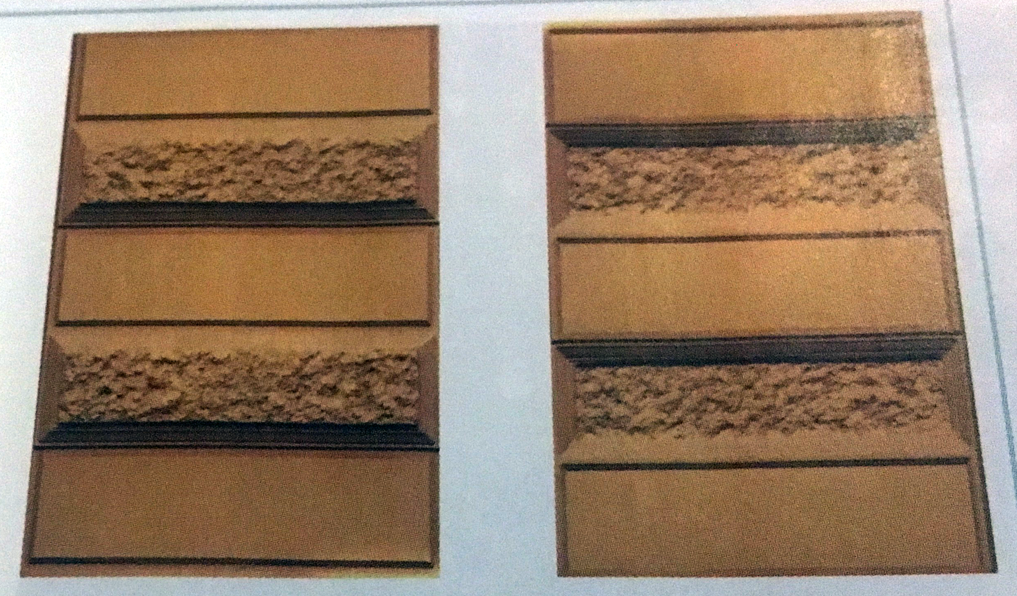
Light from Above
Notes:
§ Light-from-above assumption: usually assume light is coming from above, because the sun, most light, etc. do
Image credit: Cengage
Right is upside down of the left

Slide 29
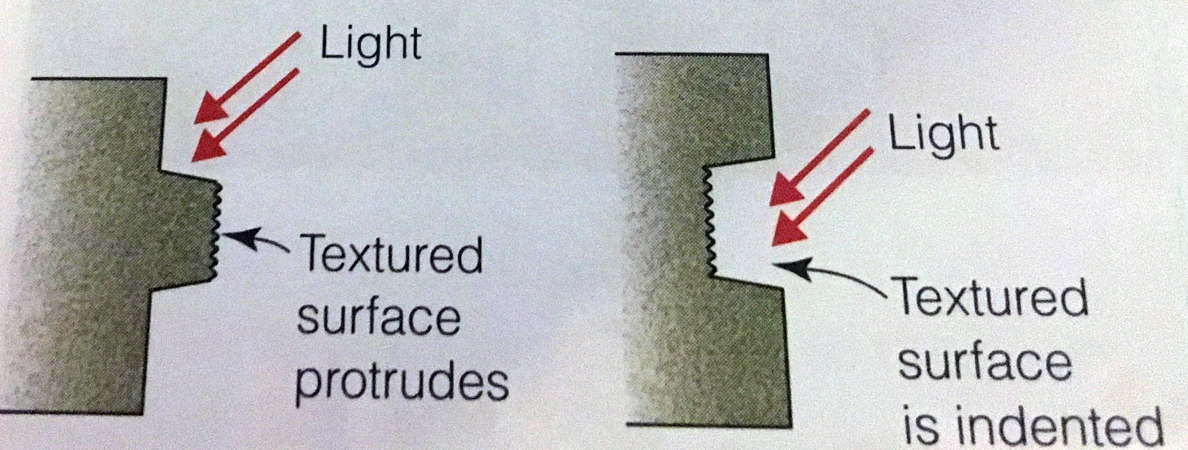
Light from Above
Notes:
§ Light-from-above assumption: usually assume light is coming from above, because the sun, most light, etc. do
Image credit: Cengage

Slide 30
Semantic Regularities
Close your eyes and then visualize or simply think about the following scenes and objects:
An office
The clothing section of a dept store
A microscope
A lion
Notes:
What does each contain?
People likely to say office has a desk with a computer on it, bookshelves, a chair
Dept store has racks of clothes, changing room, etc.
§ What a given scene usually contains: a scene schema (visualizations contain information based on our knowledge of different kinds of scenes

Slide 31
4 Perspectives on Perception
Bayesian Inference
Prior: our initial belief about about the probability of an outcome
Likelihood: the extent to which evidence is consistent with an outcome
Update our estimate of probability of an outcome based on prior and likelihood
I.e., Expectation and experience play a large role in perception, and sometimes we’re not even aware of that

Slide 32
4 Perspectives on Perception
Gestalt psychologists: perception can’t be explained by adding up small sensations and the whole is different than the sum of its parts. Have principles of organization:
Good continuation
Simplicity/Good Figure/Pragnanz
Similarity
I.e., a person’s experience can influence perception, but experience plays a smaller role than perceptual principles (i.e., perception is intrinsic)

Slide 33
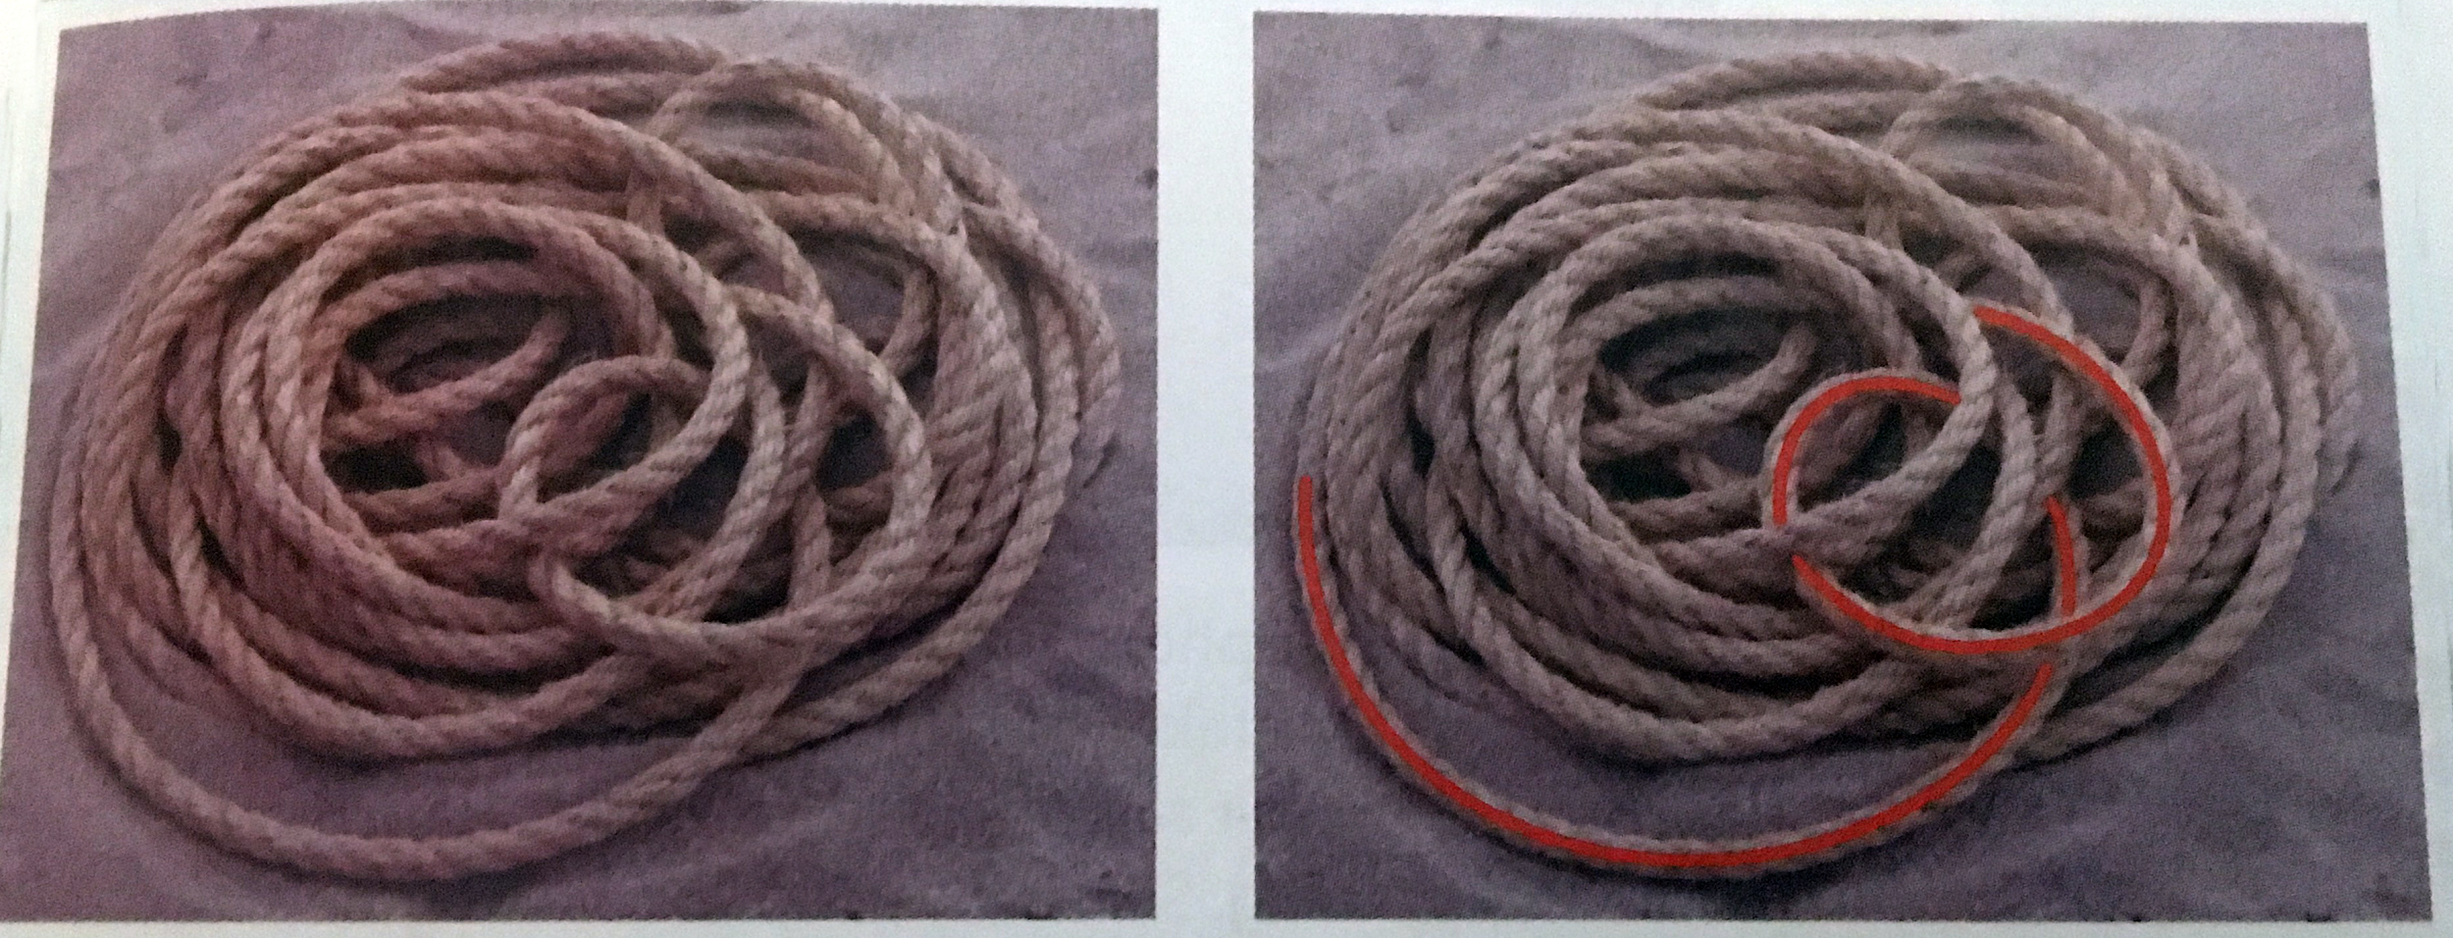
Good Continuation
Notes:
o Good continuation: points that when connected result in straight or smoothly curving lines are seen as belonging together, following the smoothest path. Objects that are overlapped by others are perceived as continuing behind the overlapping object
Image credit: cengage

Slide 34

Simplicity: Five Circles, Not 9 Shapes
Notes:
o Pragnanz (Good Figure or Simplicity): every stimulus pattern is seen in such a way that the resulting structure is as simple as possible

Slide 35

Similarity: Shirt Grouped with White Water
“Waves” - Wilma Hurskainen
Notes:
o Similarity: similar things are grouped together

Slide 36
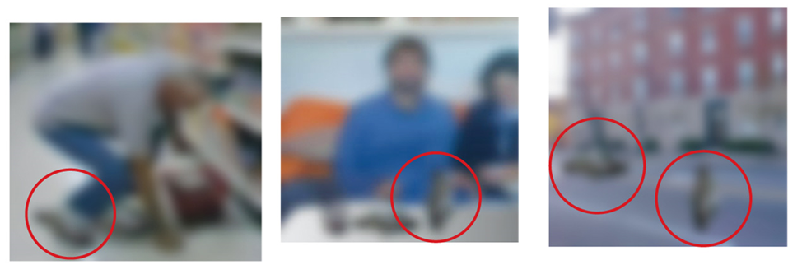
How Would Each Theory Explain This?
Notes:
Image credits:
Cengage

Slide 37
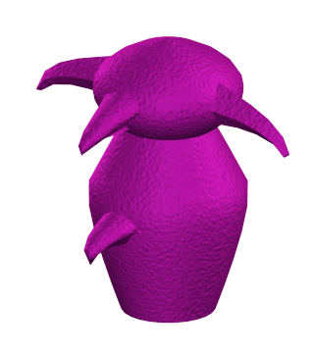
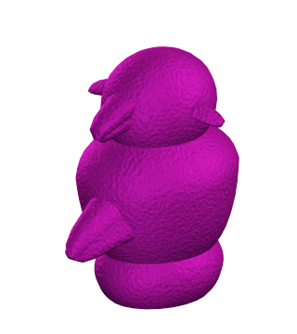
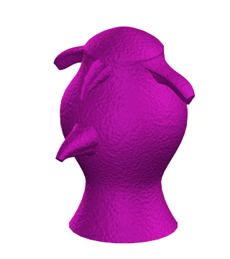
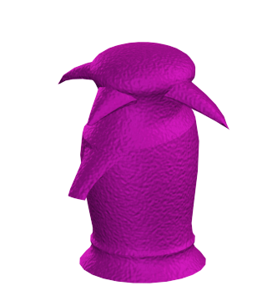
Experience-Dependent Plasticity
The structure of the brain is changed by experience: the case of Greebles (Isabel Gauthier)
Notes:
https://en.wikipedia.org/wiki/Greeble_(psychology)

Slide 38
Handout: Depth Perception
Identify the cue types that help us perceive depth with a partner, and then try to spot those cues in a 3D street art demo

Slide 39
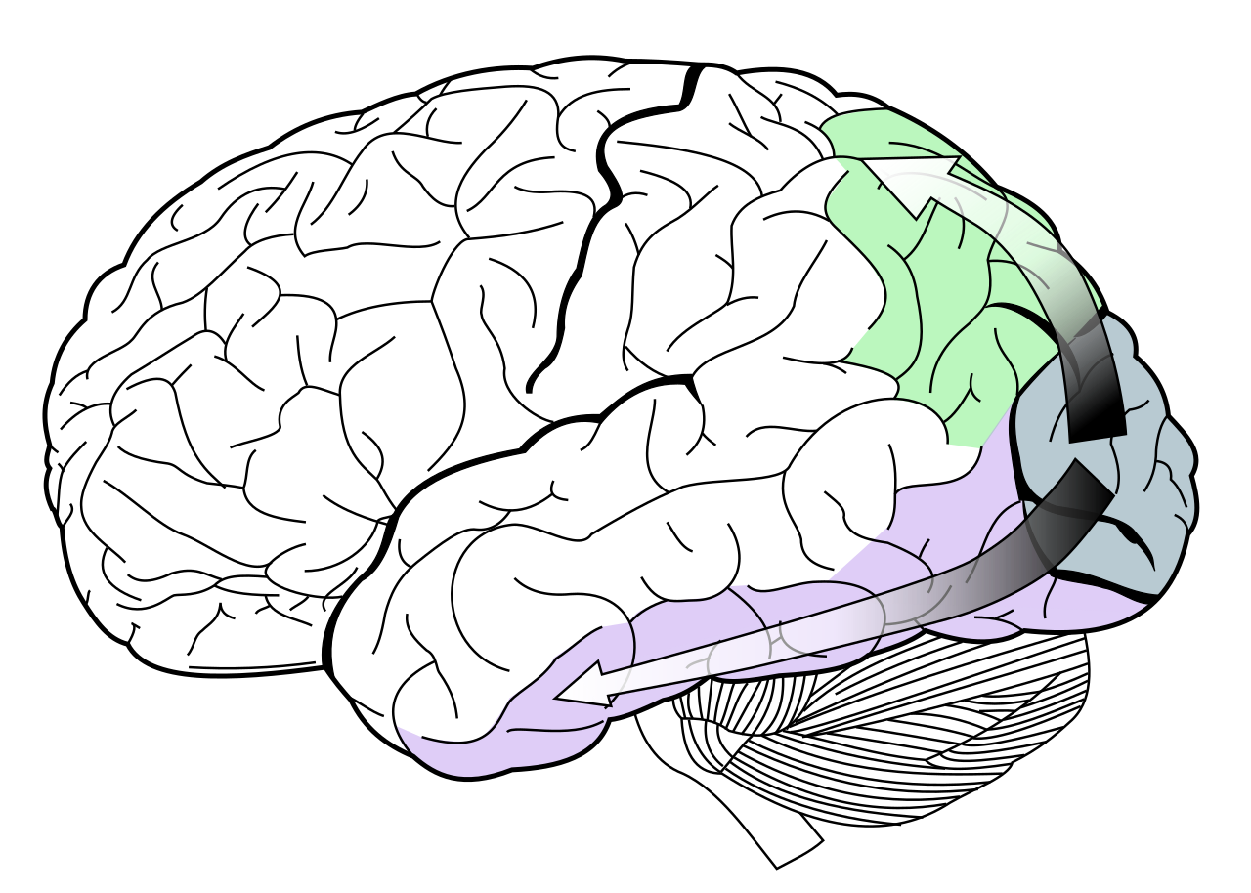
Processing Streams
Where / Action pathway
What / Perception pathway
Notes:
https://en.wikipedia.org/wiki/Two-streams_hypothesis#/media/File:Ventral-dorsal_streams.svg
o Physiology:
§ Brain ablation: the study of the effect of removing parts of the brain in animals
· Monkeys who had their temporal lobe removed had a harder time discriminating objects (identities), while monkeys who had their parietal lobe removed had a harder time determining where landmarks were located
· Pathway from striate cortex to temporal lobe: what pathway
· Pathway from striate cortex to parietal lobe: where pathway
§ Neuropsychology: the study of behavior of people with brain damage
· D.F.: suffered damage to temporal lobe
· She had difficulty rotating a card in her hand to match different orientations of a slot
o Once she started moving the card toward the slot, she was able to rotate it to match the orientation of the slot
o Did poorly in a static orientation matching task, but did well once action was involved
o One mechanism for judging orientation, another for coordinating vision and action
· Pathway from visual cortex to temporal lobe: perception pathway
· Pathway from visual cortex to parietal lobe: action pathway

Slide 40
Gruters et al. (2018)
Deconstruct and analyze the findings of an academic journal article.

Slide 41
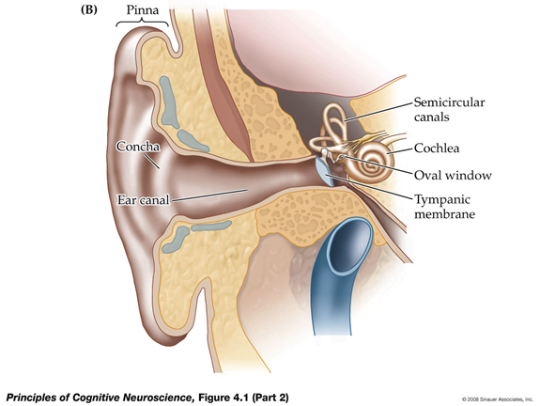
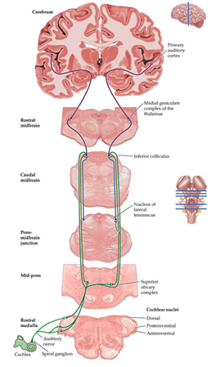
Changes in local air pressure are funneled by the external ear onto the tympanic membrane / eardrum, which then moves the bones of the middle ear to push around fluid inside the cochlea. This results in the bending of hair cells that are located on the basilar membrane of the inner ear.
Notes:
Standard textbook version of auditory processing – which does not mention anything like what the Gruters et al. paper suggests
Unlike visual information, auditory information first travels from the ear to the brainstem and the midbrain, prior to reaching the thalamus (specifically, the medial geniculate complex) and, eventually, the primary auditory cortex. One likely purpose of auditory information passing these subcortical way-stations, prior to being analyzed in detail in the cortex, is to produce a fast (but ‘dirty’) analysis of sound source location and motor reaction to the sound. This system allows us, e.g., to reflexively seek cover when a loud noise occurs nearby (without spending more time on a detailed analysis of the sound’s meaning).
Thalamic projections of the auditory pathway reach the primary auditory cortex (A1), located in the superior temporal gyrus, which in turn projects to ‘higher’, secondary auditory cortex, consisting of regions of the superior temporal cortex and the adjacent inferior parietal cortex (also called ‘auditory belt areas’).

Slide 42
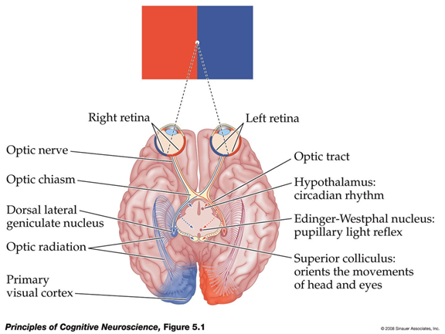
Visual information (light) from the left (right) visual field is received by the right (left) half of each retina. Crossing the optic chiasm, the left (right) halves of each
retina combine their information, first in the thalamic LGN and then in the primary visual cortex of each cerebral hemisphere, into a full representation of the contra-lateral visual field.
Notes:
Standard textbook version of visual processing – which does not mention anything like what the Gruters et al. paper suggests

Slide 43
Yong vs. Gruters; Yong vs. Dean - how do they differ?
Compare and contrast models of science communication.

Slide 44
Yong vs. Gruters
What he took:
Some details (10 ms before onset)
Methodological summary (no mention of monkeys)
Example of auditory/visual integration
The key description of the effect (and he let that be his hook)
Notes:
Yong (2018) / the finding from Gruters et al. (2018) was considered #7 on this list: https://www.theatlantic.com/science/archive/2018/12/83-things-blew-our-minds-2018/579046/

Slide 45
Yong vs. Dean
Weird image in Dean, which was interestingly from the Duke press release & provided by the scientists involved (although also interesting Obama choice for Yong)
Not a contextualization with other experts weighing in for Dean
Dean quotes straight from the university press release, which is usually pretty biased
Both quote the PI (Jenni Groh) and students, but Dean seems to have more of the press release, whereas Yong seemingly emailed or interviews other people (perhaps a function of the outlet)

Slide 46
Today’s Goals & Agenda
Continue to build a supportive classroom culture & discuss open science & methodology used for different studies.
In teams, fill out the study vignettes
Jeopardy style Qs on the open science reading
Describe some basic perceptual perspectives and principles.
Discuss 4 perspectives on perception: learning-focused (Helmholtz, Statistical Learning, Bayesian) and intrinsic (Gestalt)
If there's time, handout on depth processing cues
Deconstruct and analyze the findings of an academic journal article.
Apply the reading worksheet to Gruters et al. (2018)
Discuss the main takeaways of the Gruters paper as class
Compare and contrast models of science communication.
Yong vs. Gruters; Yong vs. Dean

Slide 47
Monday’s Work
Read Kang & Wheatley (2017) and Middlebrooks et al. (2017)
Fill out reading worksheets for both articles & for one of the articles, write tweet summaries for both a lay audience & psychologist audience
Watch NPR “Buying Attention Podcast”

Slide 48
Participation + Minute Paper
https://tinyurl.com/PSY102Participation
https://tinyurl.com/PSY102MinutePaperMay17

Slide 49
Extra Perceptual Illusions
Too many to actually go over!!

Slide 50
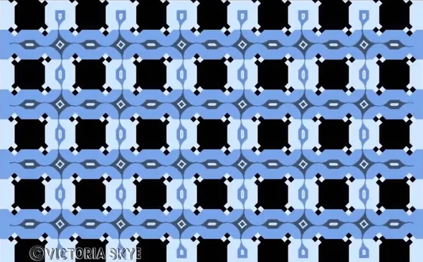
More Perceptual Illusions
Notes:
https://blogs.scientificamerican.com/illusion-chasers/the-2017-best-illusion-of-the-year-contest/?redirect=1
“In the Skye Blue Café Wall Illusion, above, Victoria Skye builds on the previous insights of the famous illusionists Richard Gregory and Akiyoshi Kitaoka, to show that or perception of rectilinear lines is a matter of opinion. You determine whether edges are parallel through a brain circuit that uses the lightness and darkness of edges to help establish the relative orientation of the lines. Presumably this is because your brain relies a lot on shadows to see where objects lie, and how they interact with the surfaces around them. So here, when Skye throws in a series of white/black diamonds at key transitions between surfaces, this causes havoc in the brain circuits, leading to misrepresentation—in perception—of the position and angles of the edges.”

Slide 51
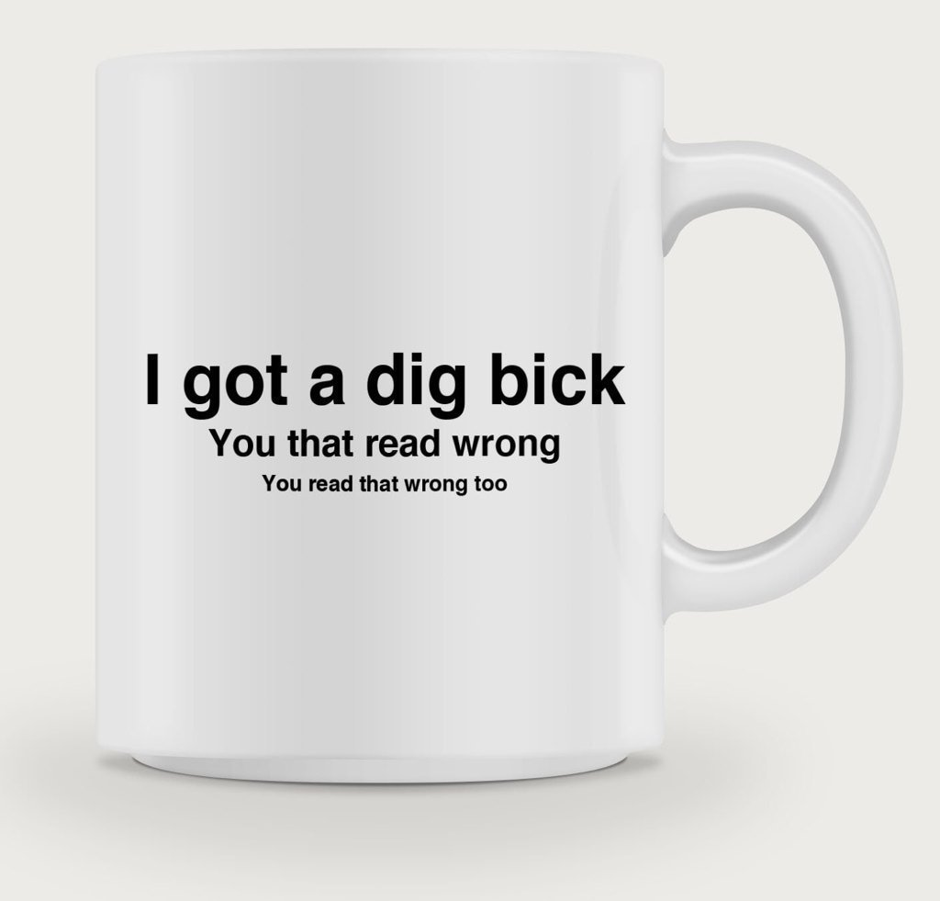
More Perceptual Illusions
Notes:
Expectations guide perception
https://twitter.com/SteveStuWill/status/1050345335145422849

Slide 52
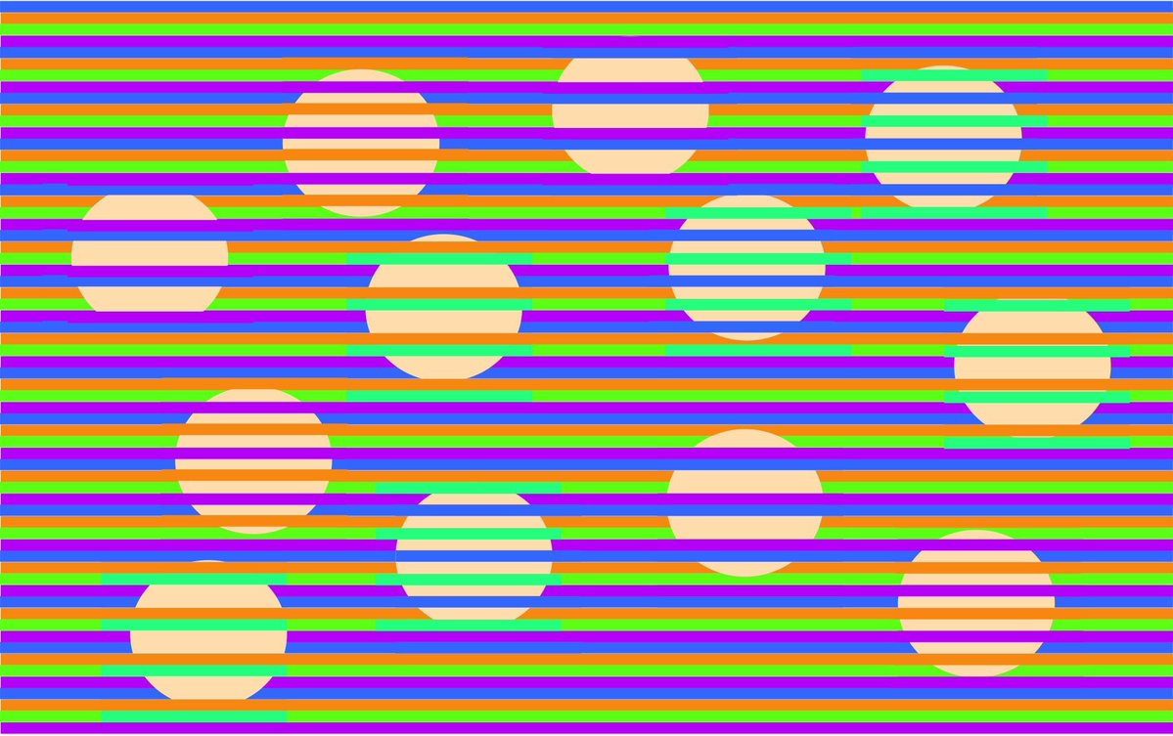
More Perceptual Illusions
Notes:
https://twistedsifter.com/2018/07/new-munker-illusion-where-every-dot-is-same-color/
A new ‘Munker illusion‘ by Engineering professor David Novick has been getting shared on Twitter where all the dots in the background are the same color (RGB 250, 219, 172) but are perceived as four different colors.

Slide 53
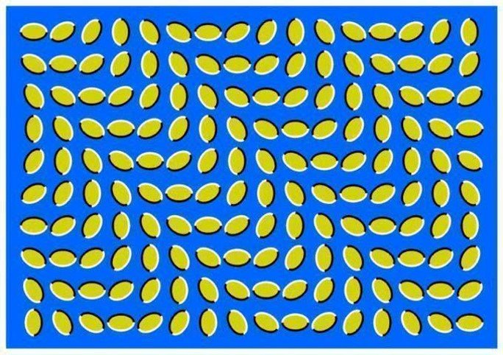
More Perceptual Illusions
Notes:
https://twitter.com/SteveStuWill/status/1050345346914607105

Slide 54
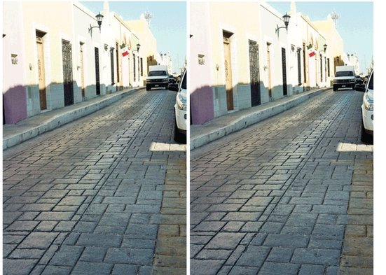
More Perceptual Illusions
Notes:
https://blogs.scientificamerican.com/illusion-chasers/the-tilted-road-illusion/

Slide 55
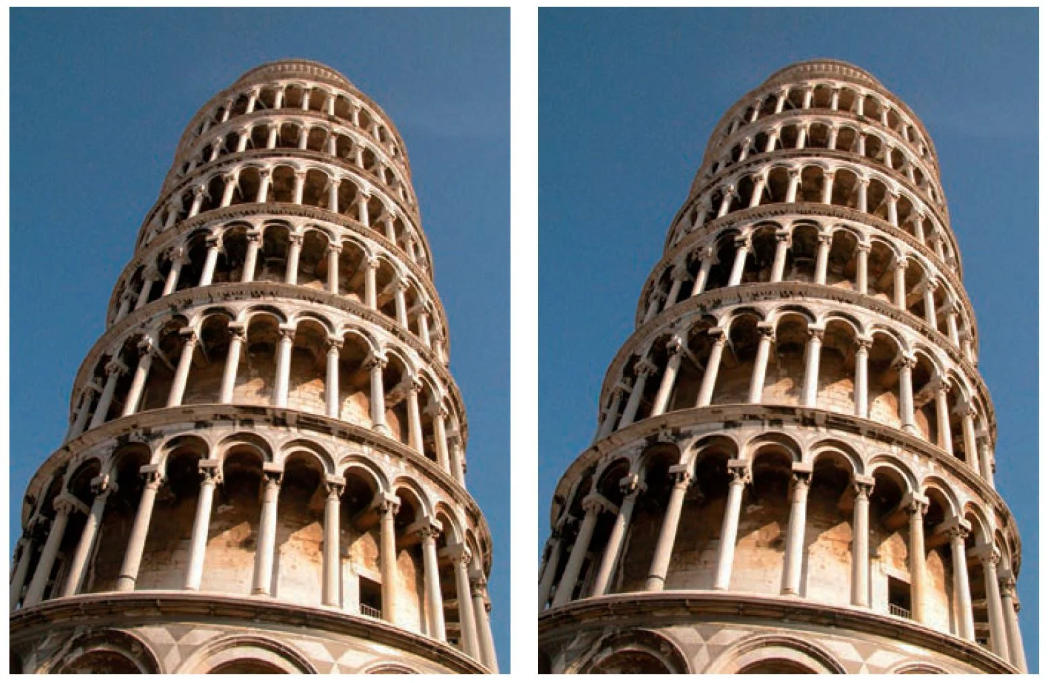
More Perceptual Illusions
Notes:
https://blogs.scientificamerican.com/illusion-chasers/the-tilted-road-illusion/

Slide 56
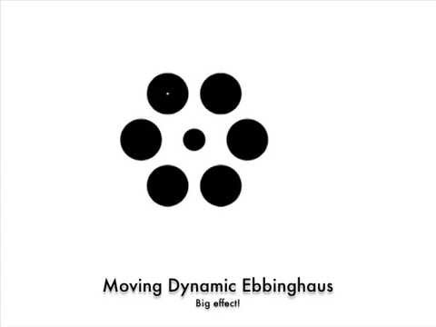
More Perceptual Illusions
Notes:
https://t.co/wReYo1466M

Slide 57
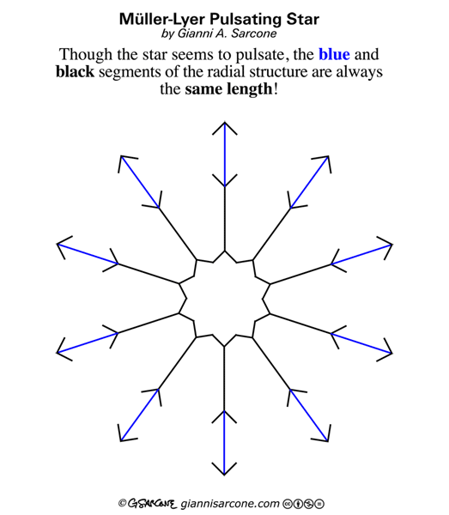
More Perceptual Illusions
Notes:
https://www.giannisarcone.com/Muller_lyer_illusion.html

Slide 58
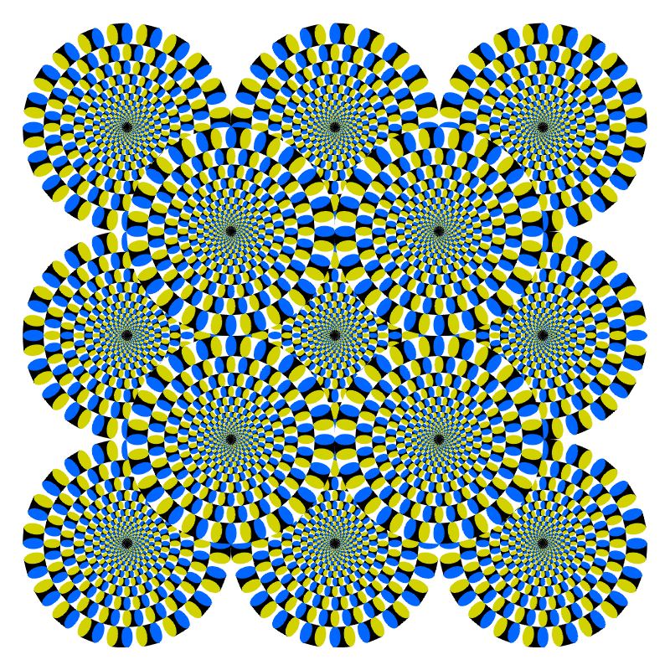
More Perceptual Illusions
Notes:
https://michaelbach.de/ot/mot-snakes/index.html; even a cat experiences it: https://twitter.com/action_brain/status/1119972965829857280
https://www.buzzfeed.com/kellyoakes/captivating-optical-illusion-gifs-that-will-make-your-brain
https://en.wikipedia.org/wiki/Spinning_Dancer
https://twitter.com/SteveStuWill/status/1050345372608917504
https://t.co/LioRrI9pAK
https://twitter.com/SteveStuWill/status/1079418299216261120
https://twitter.com/CloeCouture/status/996218489831473152
https://www.nytimes.com/interactive/2018/05/16/upshot/audio-clip-yanny-laurel-debate.html - interactive for tweet above
http://gocognitive.net/demo/light-above – demo site was not working
http://gocognitive.net/demo/mapping-your-blindspot – demo site was not working
Some other interesting perception things:
https://www.npr.org/sections/health-shots/2014/11/10/361219912/if-the-same-shade-looks-both-yellow-and-gray-whats-color
https://www.npr.org/sections/13.7/2015/03/20/393359996/we-experience-the-world-we-infer-not-the-world-as-it-is

